Slide 1
MIS 637
Data Analytics & Machine Learning
ANN – BP Algorithm
M. Daneshmand
MD-MIS 637 Fall 2020

Slide 2
Simple Example of a Neural Network
Input Layer
Hidden Layer
Output Layer
W_{0A}
  Neural Network consists of layered, feedforward, completely connected network of nodes
  Feedforward restricts network flow to single direction
  Flow does not loop or cycle
  Network composed of two or more layers
Node 1
W_{1A}
W_{1B}
Node A
W_{AZ}
Node 2
W_{2A}
Node Z
W_{2B}
Node B
W_{3A}
W_{BZ}
Node 3
W_{0Z}
W_{3B}
W_{0B}
MD-MIS 637 Fall 2020

Slide 3

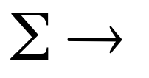


MD-MIS 637 Fall 2020

Slide 4
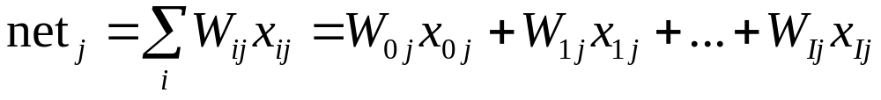
Simple Example of a Neural Network (cont’d)
  Combination function produces linear combination of node inputs and connection weights to single scalar value
  For node j, xij is ith input
  Wij is weight associated with ith input node
  I+ 1 inputs to node j
  x1, x2, ..., xI are inputs from upstream nodes
  x0 is constant input value = 1.0
  Each input node has extra input W0jx0j = W0j
MD-MIS 637 Fall 2020

Slide 5
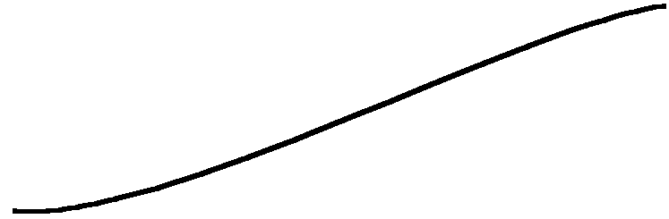
Transfer Function:
  there are different types of transfer functions,
  S- shaped (sigmoid) function is the most common form of transfer function used in ANN,
  the logistic function:
        f(x) = 1/ [1 + exp(-x)],
  defined for all values of the sum, x, with range [0,1], is the most common sigmoid function used,
  its value is about 0 when the sum of inputs is large and negative, its value is about 1 when the sum is large positive, and exactly 0.5 for zero sum,
  it is non-linear: the output of a node increases or decreases at different rates in different parts of the input range,
  it is more sensitive to variations of small values of the sum, less sensitive to large values of the sum (+ or -),
Y
- ∞ 0 +∞
MD-MIS 637 Fall 2020

Slide 6
Transfer Functions
  Threshold Function
  φ(x) = {₀¹ ^{if x>=0}_{otherwise} ➔ y_{k} = {¹₀ ^{if Vk >= 0}_{otherwise}
f(x)
x
Piecewise – Linear Function
φ(x) = {
x >= 0.5
x + 0.5 – 0.5 < x < 0.5
0 x <= -0.5
-0.5
+0.5
MD-MIS 637 Fall 2020

Slide 7
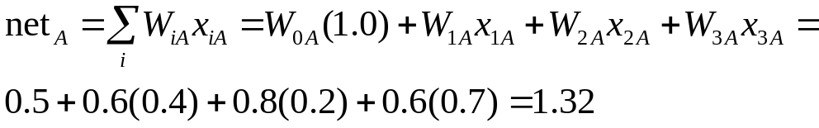
Simple Example of a Neural Network (cont’d)
x₀ = 1.0 | W_{0A} = 0.5 | W_{0B} = 0.7 | W_{0Z} = 0.5
x₁ = 0.4 | W_{1A} = 0.6 | W_{1B} = 0.9 | W_{AZ} = 0.9
x₂ = 0.2 | W_{2A} = 0.8 | W_{2B} = 0.8 | W_{BZ} = 0.9
x₃ = 0.7 | W_{3A} = 0.6 | W_{3B} = 0.4
  The scalar value computed for hidden layer Node A equals
  For Node A, netA = 1.32 is input to activation function
  Neurons “fire” in biological organisms
  Signals sent between neurons when combination of inputs cross threshold
MD-MIS 637 Fall 2020

Slide 8
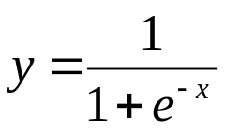
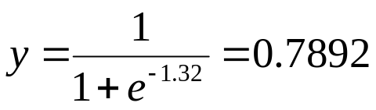
Simple Example of a Neural Network (cont’d)
  Firing response not necessarily linearly related to increase in input stimulation
  Neural Networks model behavior using non-linear activation function
  Sigmoid function most commonly used
  In Node A, sigmoid function takes netA = 1.32 as input and produces output
MD-MIS 637 Fall 2020

Slide 9
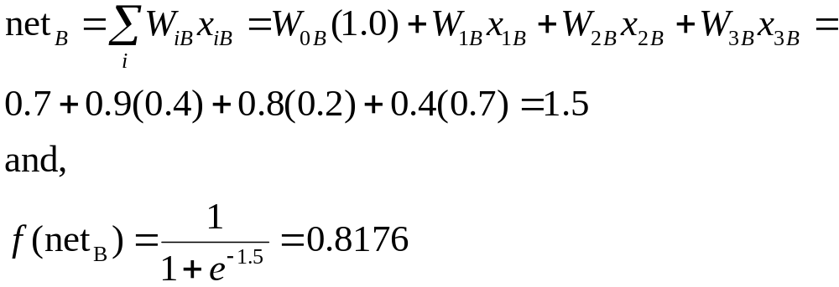
Simple Example of a Neural Network (cont’d)
  Node A outputs 0.7892 along connection to Node Z, and becomes component of netZ
  Before netZ is computed, contribution from Node B required
  Node Z combines outputs from Node A and Node B, through netZ
MD-MIS 637 Fall 2020

Slide 10
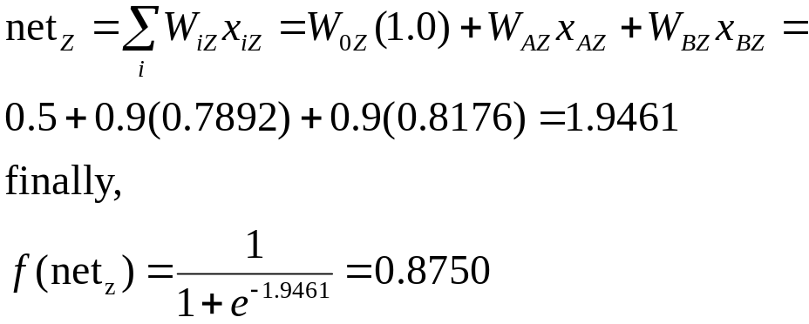
Simple Example of a Neural Network (cont’d)
  Inputs to Node Z not data attribute values
  Rather, outputs are from sigmoid function in upstream nodes
  Value 0.8750 output from Neural Network on first pass
  Represents predicted value for target variable, given first observation
MD-MIS 637 Fall 2020

Slide 11
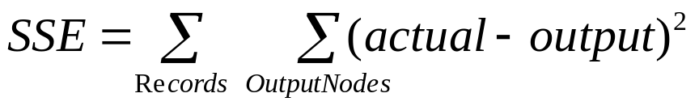
Back-Propagation
  Neural Networks are supervised learning method
  Require target variable
  Each observation passed through network results in output value
  Output value compared to actual value of target variable
  (Actual – Output) = Error
  Prediction error analogous to residuals in regression models
  Most networks use Sum of Squares (SSE) to measure how well predictions fit target values
MD-MIS 637 Fall 2020

Slide 12
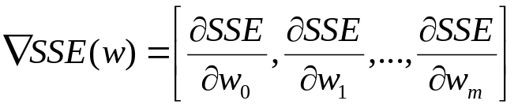
Gradient Descent Method
  Gradient Descent Method determines set of weights that minimize SSE
  Given a set of m weights w = w1, w2, ..., wm in network model
  Find values for weights that, together, minimize SSE
  Gradient Descent determines direction to adjust weights, that decreases SSE
  Gradient of SSE, with respect to vector of weights w, is vector derivative:
MD-MIS 637 Fall 2020

Slide 13
Gradient Descent Method (cont’d)
  Gradient Descent is illustrated using single weight w1
  Figure plots SSE error against range of values for w1
  Preferred values for w1 minimize SSE
  Optimal value for w1 is w*1
SSE
w_{1L}
W*₁
w_{1R}
W₁
MD-MIS 637 Fall 2020

Slide 14
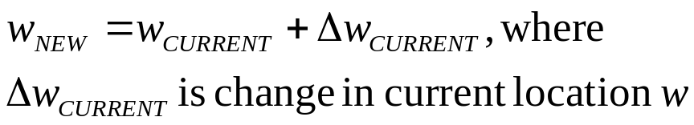
Gradient Descent Method (cont’d)
  Develop rule defining movement from current w1 to optimal value w*1
  If current weight near w1L, increasing w approaches w*1
  If current weight near w1R, decreasing w approaches w*1
  Gradient of SSE, with respect to weight wCURRENT, is slope of SSE curve at wCURRENT
  Value wCURRENT close to w1L, slope is negative
  Value wCURRENT close to w1R, slope is positive
MD-MIS 637 Fall 2020

Slide 15
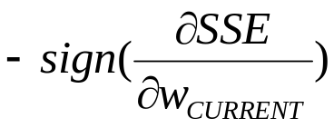
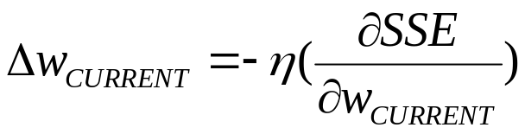
Gradient Descent Method (cont’d)
  Direction for adjusting wCURRENT is negative sign of derivative at SSE at wCURRENT
  To adjust, use magnitude of the derivative of SSE at wCURRENT
  When curve steep, adjustment large
  When curve nearly flat, adjustment small
  Learning Rate (Greek “eta”) has values [0, 1]
MD-MIS 637 Fall 2020

Slide 16
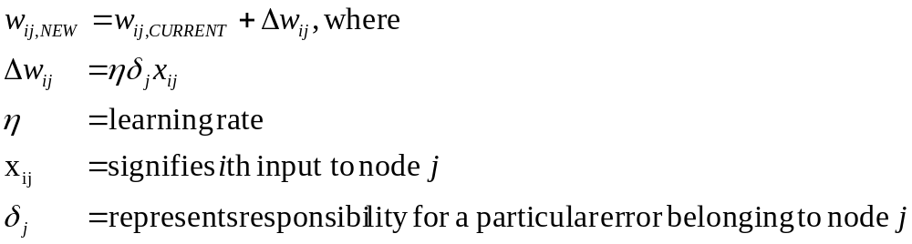
Back-Propagation Rules
  Back-propagation percolates prediction error for record back through network
  Partitioned responsibility for prediction error assigned to various connections
  Weights of connections adjusted to decrease error, using Gradient Descent Method
  Back-propagation rules defined (Mitchell)
MD-MIS 637 Fall 2020

Slide 17
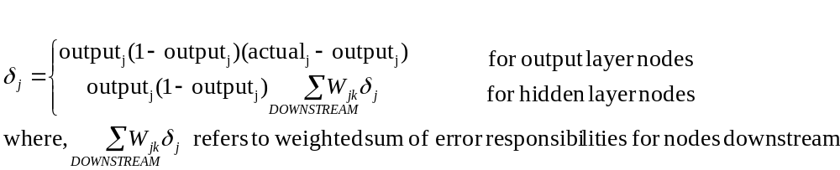
Back-Propagation Rules (cont’d)
  Error responsibility computed using partial derivative of the sigmoid function with respect to netj
  Values take one of two forms
  Rules show why input values require normalization
  Large input values xij would dominate weight adjustment
  Error propagation would be overwhelmed, and learning stifled
MD-MIS 637 Fall 2020

Slide 18
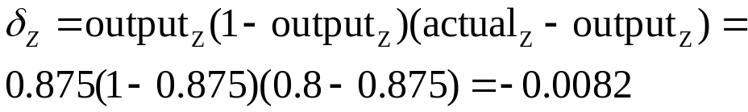
Example of Back-Propagation
  Recall that first pass through network yielded output = 0.8750
  Assume actual target value = 0.8, and learning rate = 0.01
  Prediction error = 0.8 - 0.8750 = -0.075
  Neural Networks use stochastic back-propagation
  Weights updated after each record processed by network
  Adjusting the weights using back-propagation shown next
  Error responsibility for Node Z, an output node, found first
MD-MIS 637 Fall 2020

Slide 19
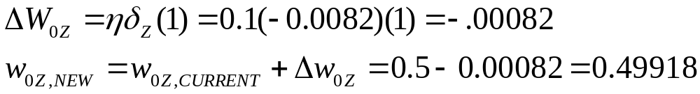
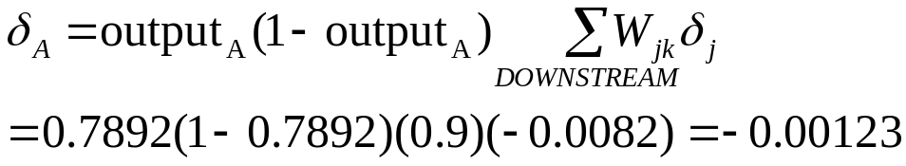
Example of Back-Propagation (cont’d)
  Now adjust “constant” weight w0Z using rules
  Move upstream to Node A, a hidden layer node
  Only node downstream from Node A is Node Z
MD-MIS 637 Fall 2020

Slide 20
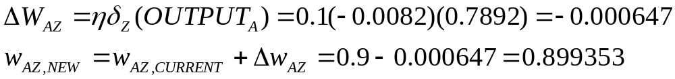
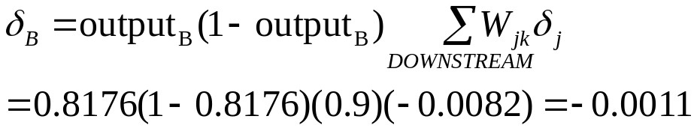
Example of Back-Propagation (cont’d)
  Adjust weight wAZ using back-propagation rules
  Connection weight between Node A and Node Z adjusted from 0.9 to 0.899353
  Next, Node B is hidden layer node
  Only node downstream from Node B is Node Z
MD-MIS 637 Fall 2020

Slide 21
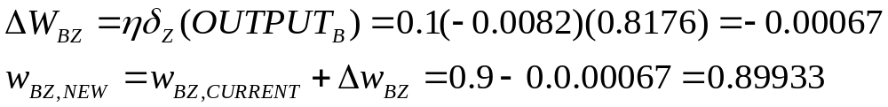
Example of Back-Propagation (cont’d)
  Adjust weight wBZ using back-propagation rules
  Connection weight between Node B and Node Z adjusted from 0.9 to 0.89933
  Similarly, application of back-propagation rules continues to input layer nodes
  Weights {w1A, w2A, w3A , w0A} and {w1B, w2B, w3B , w0B} updated by process
MD-MIS 637 Fall 2020

Slide 22
An Application of Neural Network Modeling (US Census Data)
  Task: predict whether person’s income <= $50,000 using following predictor fields
  Numeric Predictors: Age, Capital Gains, Capital Losses, Hours Worked per Week, Years of Education
  Numeric variables are normalized [0, 1]
  Categorical Predictors: Gender, Marital Status, Race, Work Class
  Some low-frequency values for Marital Status and Work Class attributes collapsed
MD-MIS 637 Fall 2020

Slide 23
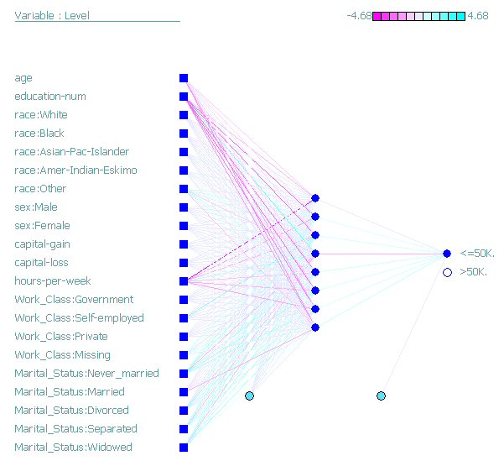
Application of Neural Network Modeling
  Insightful Miner models adult data set using network
  Model uses one hidden layer with 8 nodes
  Algorithm iterates 47 times (epochs) before terminating
  Resulting network model shown
MD-MIS 637 Fall 2020

Slide 24
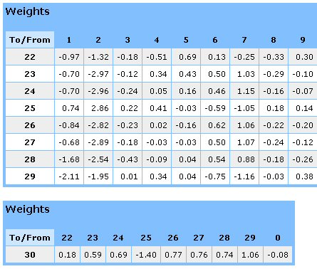
Application of Neural Network Modeling (cont’d)
  Input nodes appear on left, one per attribute
  Eight hidden nodes in center
  Includes single output node, whether income <= $50,000
  Table below shows network weights from model
  Input nodes numbered 1 – 9, hidden nodes 22 – 29
  Weight from input node Age (1) to topmost hidden node (22) is -0.97
MD-MIS 637 Fall 2020

Slide 25
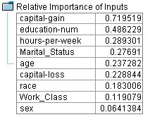
Application of Neural Network Modeling (cont’d)
  Estimated prediction accuracy of model is 82%
  Approximately 75% of records have income <= $50,000
  Sensitivity Analysis performed with Clementine, shown below
  capital-gain and education-num attributes are most important predictors of those with income <= $50,000
  However, gender (sex) not highly-predictive
  Further analysis required to develop model
MD-MIS 637 Fall 2020

